Slide 1
Note to Instructors
Each student has different foundational skills so some students may need more support or instruction than others, while others may need less.
Based on your students, you can choose which slides or information is best suited for them.

Slide 2
Professional Skills Vocabulary
Pre-Employment Transition Services
Workplace Readiness Training

Slide 3
What are Professional Skills?
Professional skills are the things we do to be good workers, team members, and students. These skills help people get jobs, keep jobs, and work well with others.

Slide 4

Workplace Communication
The exchange of information and ideas, both written and verbal, among employees, peers, and supervisors in a professional setting.

Slide 5

Work Ethics
The set of moral principles and values that guide an individual's behavior and attitude in the workplace, including honesty, reliability, and dedication.

Slide 6

Basic Customer Service
The assistance and support provided to customers who need help, information, or guidance. It’s about being clear, kind, and making sure the person gets the support they need.

Slide 7

Teamwork
The ability to work effectively with others, combining individual strengths to achieve shared goals. It involves communication, cooperation, and mutual support among team members to overcome challenges and complete tasks efficiently.

Slide 8

Networking
Using existing relationships or meeting new people and building relationships that can help both of you in your interests or careers.

Slide 9

Workplace Health and Safety
Practices and procedures designed to prevent accidents, injuries, and illnesses in the workplace, ensuring the well-being of all employees.

Slide 10

Job Seeking Skills
The abilities and techniques used to search for, apply to, and secure employment, including resume writing, interviewing, and following up with potential employers.

Slide 11
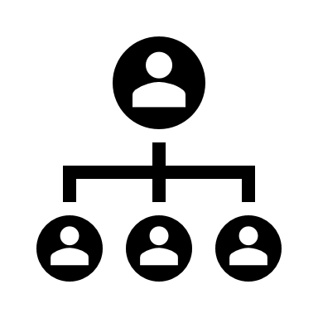
Business Organization / Hierarchy
The structure of a company that defines roles, responsibilities, and reporting relationships among employees, from entry-level to top management.

Slide 12

Employer Expectations
The standards, behaviors, and performance levels that employers anticipate from their employees in the workplace.

