Slide 1
Preparing for a Job Interview

Slide 2

I am excited about my upcoming job interview! This is an important step for me, and I want to do my best. Here are some things I will remember to help me prepare.

Slide 3




Importance of Personal Hygiene
I know that personal hygiene is important. Before my interview, I will take a shower, brush my teeth, comb my hair and use deodorant. It feels good to be clean, and it helps others feel comfortable around me.

Slide 4



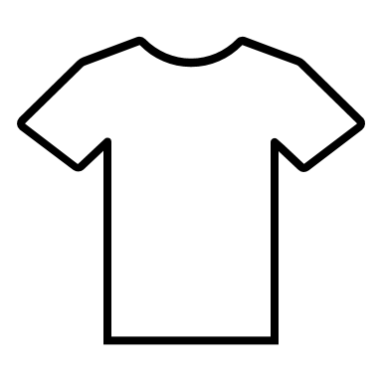


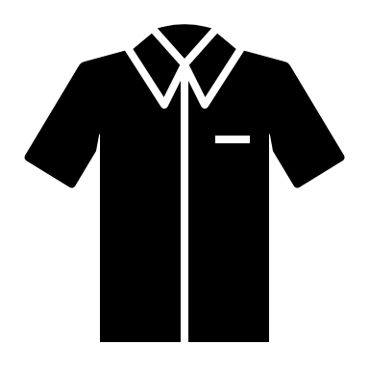
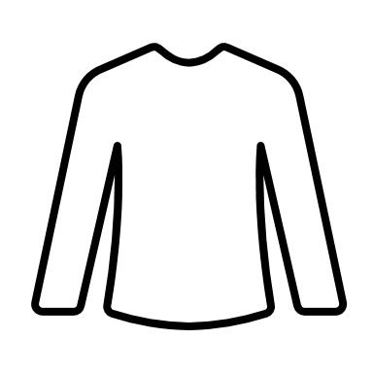


Choosing Appropriate Clothing
I will wear clothes that are neat and suitable for my interview. I can choose a nice shirt and pants or a dress. I want to look professional because it shows that I care about the job. I will make sure that my clothes do not have wrinkles, holes or stains on them. Laying out my clothes the night before will help manage my time better the day of the interview and make me feel less rushed.

Slide 5

Practicing the Route to the Company
Before the interview day, I will practice my route to the company. I can use a map or a navigation app to find the best way. If I drive, I will check that my car is ready. If I take public transportation, I will learn the schedule. I want to arrive on time, so I will leave early.

Slide 6

Practicing Interview Questions
Before the interview, I will practice answering common interview questions with someone I trust. I can ask them to help me by role-playing the interview. This will help me feel more comfortable when it is my turn.

Slide 7

What to Expect During the Interview
I will walk into the interview room and greet the interviewer with a smile. I will shake hands if it feels comfortable. During the interview I will try to maintain eye contact, sit up straight, and try not to fidget. This will show them that I am interested and engaged in the conversation.

Slide 8


When Answering Questions
When I am answering questions....
I will use a calm and clear voice when answering questions.
I will pay attention to the interviewer's body language to understand how they feel.
I will keep my phone in my bag. I will only use it after the interview is over.

Slide 9

Asking Questions After the Interview
At the end of the interview, I will have a few questions ready to ask about the job. This shows that I am interested in the position and want to know more.

Slide 10

How to Follow Up After the Interview
After the interview, I can send a thank-you email to the interviewer. I will thank them for their time and say that I appreciate the opportunity. This shows that I am polite and professional.

Slide 11
I am excited to take these steps to prepare for my job interview. I know that by following this plan, I will feel more confident and ready to succeed!

Slide 12

Let's practice some sample mock interview questions.

Slide 13
Question 1
Question:
Answer:
My name is ____, and I am ____ years old.
I go to ____ High School.
I like to ____ (activity/hobby).
I have experience in ____ (job, volunteering, or skills).
Tell me about yourself.

Slide 14
Question 2
Question:
Answer:
I want to work here because ____.
I think I would be good at this job because ____.
Why are you interested in this company/job?

Slide 15
Question 3
Question:
Answer:
I am good at ____.
I can ____ (skill or task) very well.
People say I am ____ (positive trait, like helpful or friendly).
What are your strengths?

Slide 16
Question 4
Question:
Answer:
Sometimes, I have trouble with ____, but I am working on it.
I want to get better at ____.
I ask for help when I need it with ____.
What are your weaknesses?

Slide 17
Question 5
Question:
Answer:
First, I ____, then I ____.
I make a list of what I need to do.
I finish important tasks first.
How do you prioritize your work?

Slide 18
Question 6
Question:
Answer:
If there is a problem, I try to ____.
I talk to the person and ____.
I ask for help from ____.
Describe how you deal with conflict in the workplace or at school.

Slide 19
Question 7
Question:
Answer:
I like to work in a place that is ____.
I like when my boss is ____.
I work best when ____.
What is your preferred work environment / leadership style?

Slide 20
Question 8
Question:
Answer:
One time, I disagreed with ____ and I _____ to resolve the issue.
I listened to the other person and then I ____ to resolve the issue.
The problem I had with my ____ was ____ and together we worked it out by ____.
Tell me about a time that you disagreed with a co-worker or supervisor. How did you resolve the situation?

Slide 21
Question 9
Question:
Answer:
I worked with ____ on ____.
We helped each other by ____.
Together, we ____.
Describe a time that you had to work together with someone.

