Slide 1
Parts and Pieces of the IEP
Vocabulary Review

Slide 2
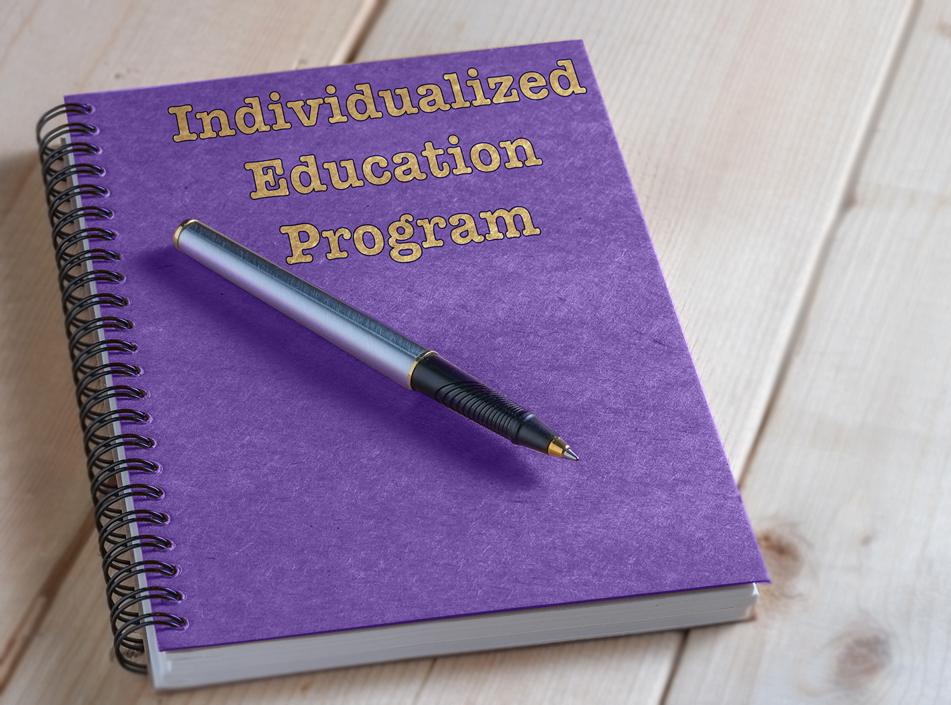
Individualized Education Program (IEP)
This is an individualized plan created by a team of educational professionals, caregivers and the student that outlines what a student needs to learn and what help and supports they need to have in place to learn the skills and goals listed.

Slide 3
Future Planning
A statement that can be made by you, your staff, and/or your caregivers about what you want to do as you grow up and prepare to graduate high school. This can include future plans for employment, school, and life.

Slide 4
Profile
A summary of who you are, your preferences, interests, needs and strengths (PINS).

Slide 5
Transition Planning
A plan that will help outline what you will do when you graduate high school. This plan should include goals around education, employment and independent living.

Slide 6
Post-Secondary Education
Learning that happens after high school, like college, a trade school, adult enrichment, or vocational training.

Slide 7
Competitive Integrated Employment
A job where you work alongside people without disabilities, do the same job tasks, and earn a comparable wage for your work.

Slide 8
Independent Living
Being able to take care of yourself, with or without supports, which includes things like cooking your own meals, cleaning your home, and managing your money.

Slide 9
Present Level of Performance
This describes how well you are doing in school right now with a particular subject. This should include what you have been working on, how you are doing with the content, and what supports you may need to do better.

Slide 10
Annual Goals
There are academic areas you want to learn or get better at during the school year. Annual goals should be developed based on your present level of perforce in the academic category and should build off previous year's goals.

Slide 11
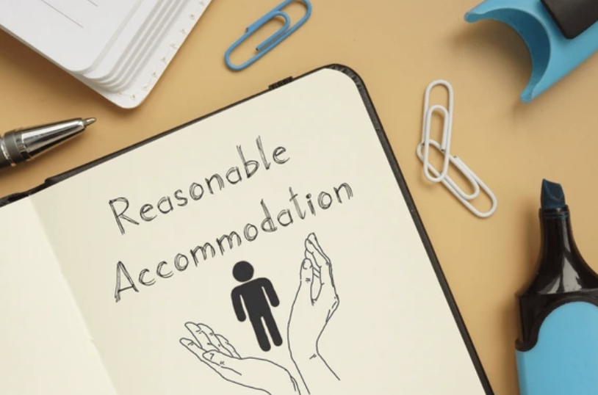
Accommodations
These are special types of help that make it easier for you to learn. They might include things like having extra time on tests or using a computer to write instead of using a pencil.

Slide 12
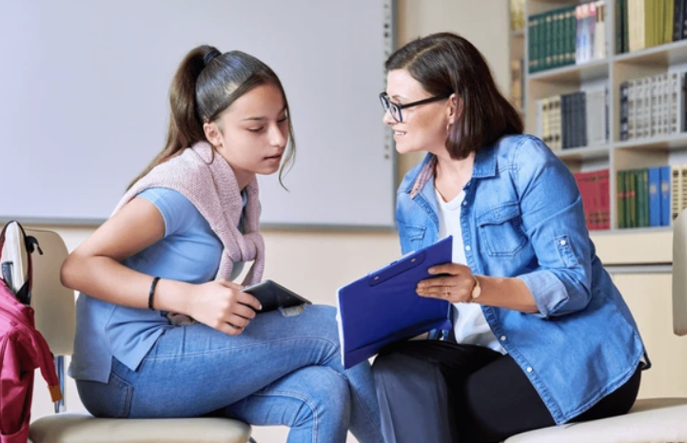
Modifications
These are changes made to what you're learning to help you succeed. It might mean learning different things or in different ways than other students in your class.

Slide 13
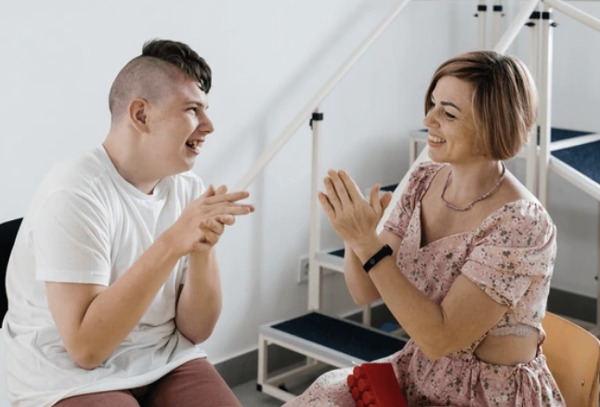
Related Services
These are professional staff that help you at school to achieve your transition and annual goals. These professionals could be a speech therapist, occupational therapist, behavior support professional, or physical therapist to name a few.

Slide 14
Meeting Participants
These are the people who come to your IEP meeting. They might include your caregivers, teachers, advocates and other professionals who help plan your education.

